Slide 1

Arrays

Slide 2
Outline
Array
Array in java
Random access
Multi dimensional array
Jagged/Ragged array
System.arraycopy()
Random Class
Interview Questions

Slide 3
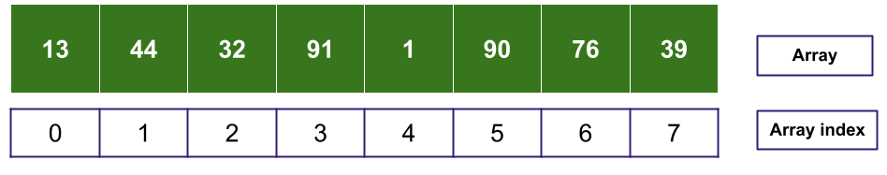
Array
In computer science, an array is a data structure consisting of a collection of elements (values or variables), each identified by at least one array index or key.

Slide 4
Array in java
Array reference
Creating Arrays
Accessing Elements
Default value
Traversing Arrays
Anonymous array
How Random Access performed

Slide 5
Random Access
short[] numbers = new short[]{2, 102, 3174, 6};
2
102
3174
6
…. | 00000000 | 00000010 | 00000000 | 01100110 | 00001100 | 01100110 | 00000000 | 00000110 | ….
index
0 | 1 | 2 | 3
2001 | 2002 | 2003 | 2004 | 2005 | 2006 | 2007 | 2008 | 2009 | 2010
Memory address
base index
numbers[n] = base_index + data_type_size * n

Slide 6
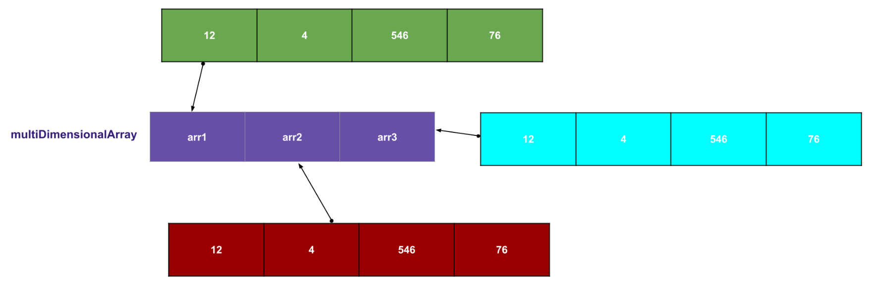
Multi dimensional array

Slide 7
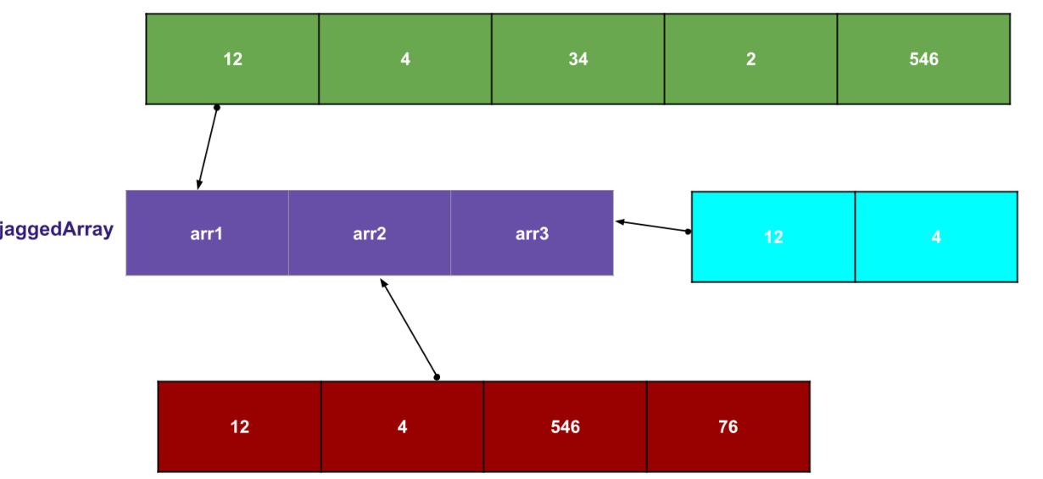
Jagged/Ragged array

Slide 8
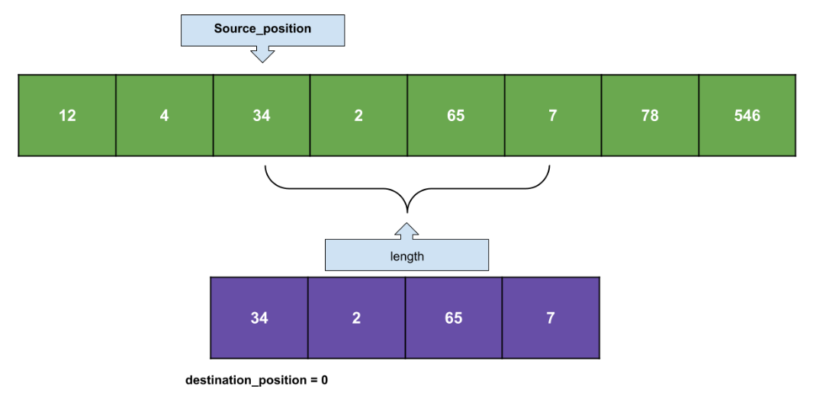
System.arraycopy()
arraycopy(Object src, int srcPos, Object dest, int destPos, int length);

Slide 9
Random Class
Used to generate random numbers
Oracle Documentation

Slide 10
Interview Questions

Slide 11
“Whatever we believe about ourselves and our ability comes true for us”

